Slide 1
splunk
Splunk is a powerful software platform designed for searching, monitoring, and analyzing machine-generated big data via a web-style interface. It captures, indexes, and correlates real-time data in a searchable repository, from which it can generate graphs, reports, alerts, dashboards, and visualizations.

Slide 2
Topic covered
WHAT IS SPLUNK ?
JOURNEY OF SPLUNK ?
PROPERTIES OF SPLUNK ?
ALERTS ?
SPLUNK VERSION ?
FEATURES OF SPLUNK ?
SPLUNK ENV ?
TYPES OF COMMANDS ?
USE CASES OF SPLUNK ?
SPLUNK LOGS ?
BENEFITS OF SPLUNK ?
ESSENTIAL FEATURES OF SPLUNK ?

Slide 3

Splunk Technology
Splunk Inc. is an American software company based in San Francisco, California, that produces software for searching, monitoring, and analyzing machine-generated data via a web-style interface .

Slide 4
Parent organization: Cisco
Founders: Michael Baum, Rob Das, Erik Swan
CEO: Gary Steele
Revenue: 365 crores USD (2023)
Founded: October 2003

Slide 5

splunk properties
Splunk is used for several key reasons, primarily centered around its ability to handle and analyze large volumes of machine-generated data. Here are some of the primary reasons organizations use Splunk:
Log Management: Splunk excels at aggregating and indexing log data from multiple sources, making it easier to search, analyze, and manage logs.

Slide 6
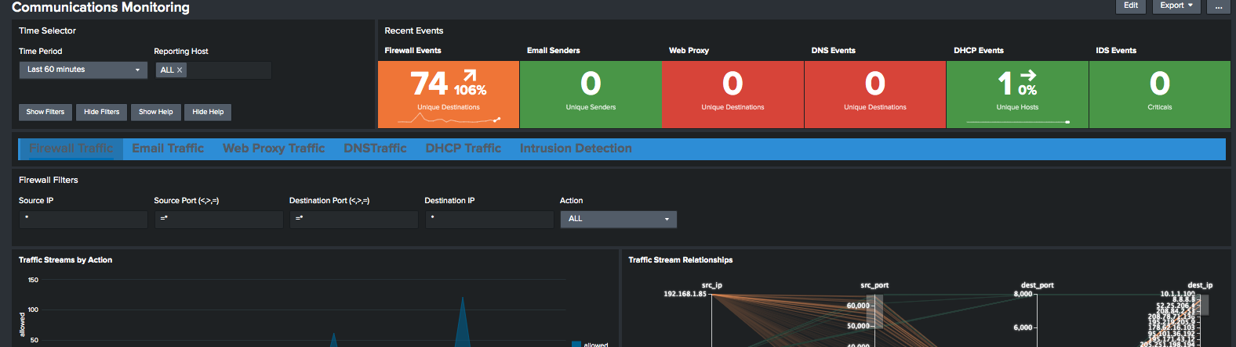
Real-Time Monitoring: Splunk provides real-time monitoring of various systems and applications, enabling organizations to detect issues and respond quickly.

Slide 7
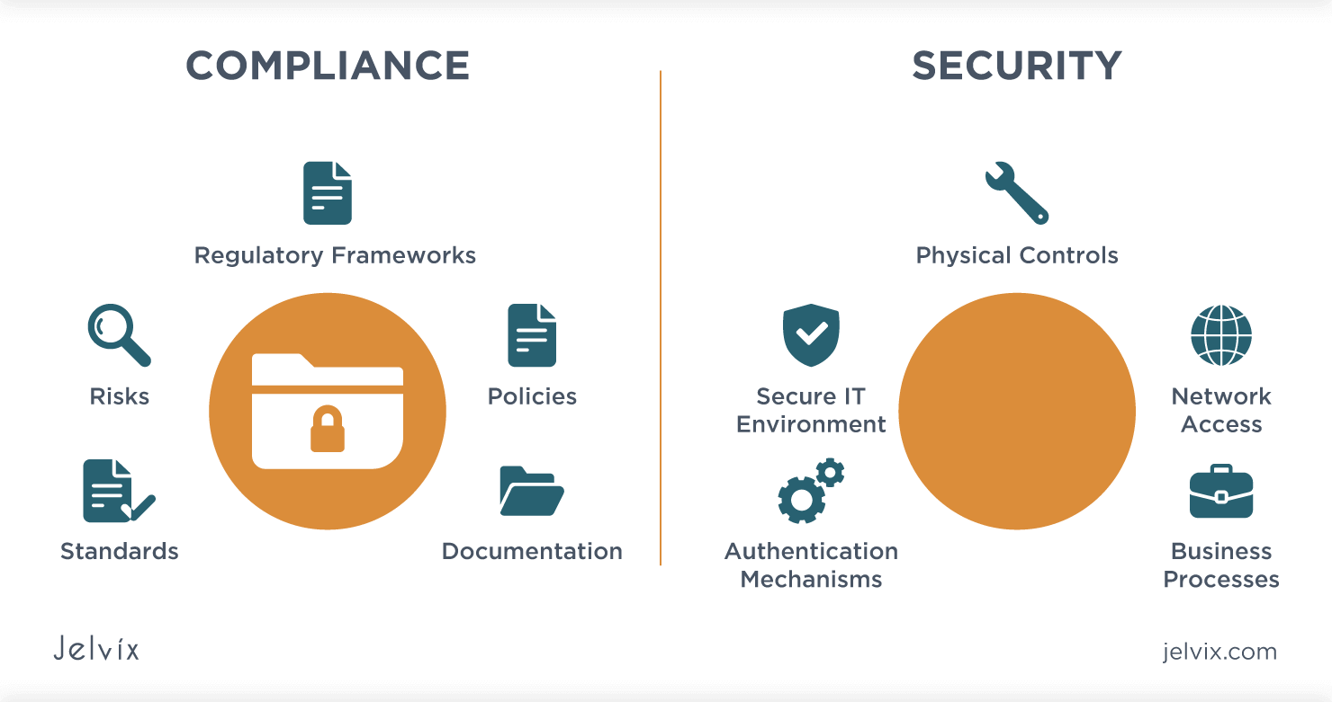
Security and Compliance: Splunk is widely used for security information and event management (SIEM). It helps detect and respond to security threats, monitor compliance, and manage incident response.

Slide 8

Automation: Splunk can automate repetitive tasks and workflows, which helps in improving efficiency and reducing the chance of human error.

Slide 9

Operational Intelligence: By analyzing machine data, Splunk helps organizations gain insights into their operations, leading to improved decision-making and operational efficiency.
Troubleshooting and Problem Resolution: Splunk helps in quickly identifying and resolving issues by providing a comprehensive view of system and application logs.
Data Analytics and Reporting: Splunk's powerful search capabilities and analytics tools enable users to generate reports, create dashboards, and visualize data to understand trends and patterns.

Slide 10
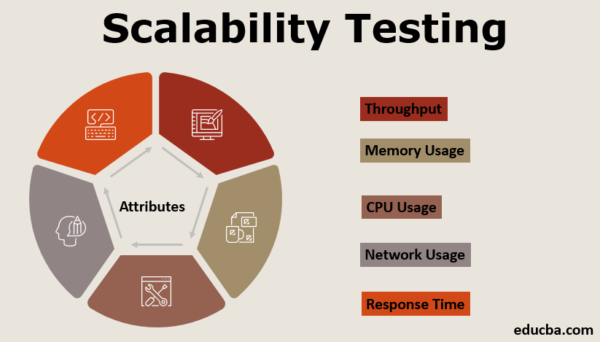
Scalability: Splunk can handle large volumes of data, making it suitable for organizations of all sizes, from small businesses to large enterprises

Slide 11
Machine Learning: Splunk incorporates machine learning capabilities that allow users to build predictive models, detect anomalies, and gain deeper insights from their data.
Integration: Splunk can integrate with a wide range of third-party applications and services, enhancing its utility across different environments and use cases.
Splunk is a big data platform that simplifies the task of collecting and managing massive volumes of machine-generated data and searching for information within it. The technology is used for business and web analytics, application management, compliance, and security.

Slide 12
Splunk Alerts
Alerts occur when particular criteria are met for the search results. When alerts activate, we can use the warning actions to respond. It is used to monitor specific events and respond to them. It includes facts, instructions, and warning action scenarios for use.
The alerting workflow
Alerts combine a saved search, type and trigger configurations, and action alerts. Here are some details of how the various portions of an alert work together.

Slide 13
Real-time alert
Real-time alerts constantly scan for incidents. In circumstances where immediate monitoring and responses are relevant, they can be useful. We can use real-time warnings that occur once per outcome or only if those conditions are met within a limited time span of rolling.
Per-result triggering
A real-time alert with a triggering condition is sometimes referred to as an "alert per outcome" Use this type of alert and trigger to search for events continuously and get notifications when events occur.
Here are a few examples of using an actual-time alarm with triggering per-result.
A website administrator on social networking needs to learn if authentication errors occur. She sets up a real-time alert to look for failed attempts to log in. She chooses a trigger condition per-result so she can track any attempt at failed login.
An admin requires real-time control of a series of hosts for errors. Some errors need a more immediate response than others. A real-time warning is set up by the admin with a trigger condition per-outcome. He is the one who controls the flow of the alert using a field representing the less urgent error code and a suppression period of one hour. The alarm causes any urgent error but for less critical errors at most once in an hour.

Slide 14
Splunk Versions
There are three different versions of Splunk
Splunk Enterprise
Splunk Light
Splunk Cloud

Slide 15
Splunk Enterprise
Big IT enterprise uses the Splunk Enterprise Version. With the help of the Splunk tool, we can collect and analyze the data from mobile phones, websites, and applications, etc.
Splunk Cloud
Splunk Cloud is a website that is the host. It possesses the same features as the company version. It can be used from Splunk or the cloud platform AWS.
Splunk Light
The free version of Splunk Illumination. It enables scanning, recording, and editing of your log data. Compared with other versions, it has limited functionalities and features.

Slide 16
Features of Splunk
Data Ingestion
In Splunk, we can import or insert the date from different data formats like - JSON, XML, and weblogs and application logs that have unstructured system data. The unstructured data can be modeled as the consumer wants in a data structure.
Data Indexing
Splunk indexes the ingested data for speedier search and query on different conditions.

Slide 17
Data Searching
Splunk analysis involves using the indexed data to establish graphs, to forecast future trends, and to find patterns in the data.
Using Alerts
Used to trigger emails or RSS feeds when a certain requirement is identified in the data that is being analyzed.
Dashboards
When we searched anything, the search result is displayed in the dashboard in the form of maps, reports, pivots, etc.
Data Model
The indexed data may be modeled into one or more data sets based on domain expertise. It leads to more straightforward navigation by end-users who evaluate the business cases without understanding the language techniques used by Splunk to process information.

Slide 18
Splunk Environment
We are going to install the Splunk Enterprise version. The question arises that why not any other version apart from this version is because it contains all the options that are typically present in this kind of tool. So, we will enterprise version. It is a trial version, that is valid for 30 days only. It has all the premium features as long as the trial goes. It is available for all the primary operating system. We are going to install it on windows and Linux platform.

Slide 19
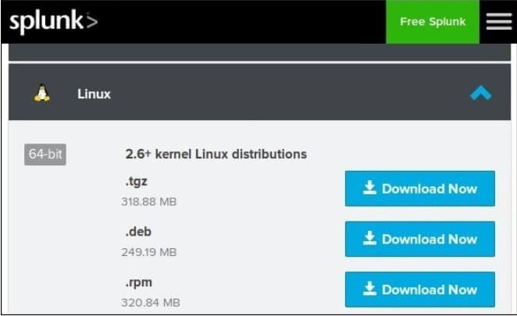
Installing Splunk on Linux Platform
Step 1: Click on the Download Now button that is in front of .deb package.

Slide 20
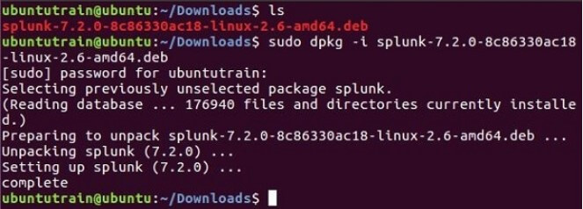
Step 2: Go to the Downloads directory in from the terminal and install the package. For reference, you can use the image below.

Slide 21
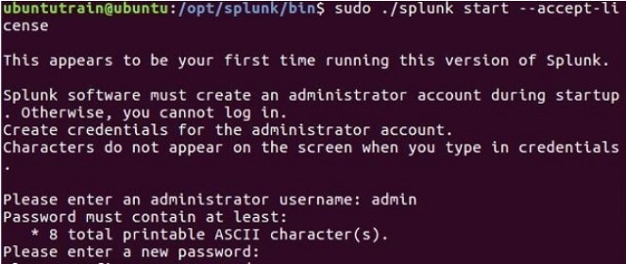
Step 3: Once the installation of Splunk is done, you can start Splunk by accepting its terms and conditions.
Next, it will ask for the user name and password. You must note down and remember it as you will need these credentials.

Slide 22
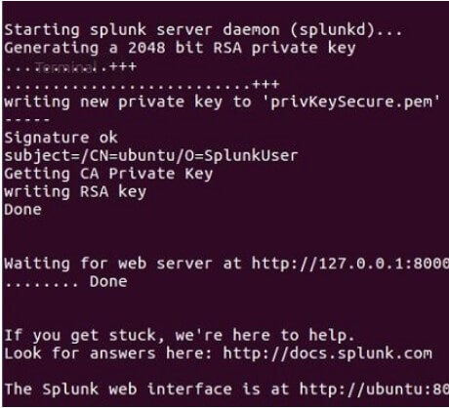
Step 4: Now the Splunk server will start, and you have to mention the URL so that it can access the Splunk Interface.

Slide 23
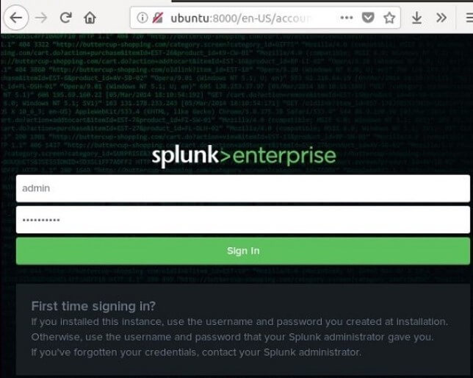
Step 5: Once it is done, you will be redirected to the browser, or you can open it manually.
The Splunk interface displays on the browser. Provide the id and password that you have created earlier.
You have successfully installed Splunk on your Linux system.

Slide 24

Splunk - Types of Command
Splunk's Search Processing Language (SPL) includes a wide variety of commands that allow users to perform different types of data operations and analyses. These commands can be broadly categorized into several types based on their functionality. Here are some of the primary types of commands in Splunk:

Slide 25

Search Commands
search: The basic command to retrieve events from indexes.
index: Specifies the index to search in.
sourcetype: Filters results by source type.
host: Filters results by host.

Slide 26

Transforming Commands
stats: Performs statistical calculations on search results.
timechart: Creates a time-based chart of results.
chart: Generates a chart based on search results.
top: Finds the most common values in a field.
rare: Finds the least common values in a field.

Slide 27

Filtering Commands
where: Filters search results based on specified conditions.
rex: Extracts fields using regular expressions.
regex: Filters events using regular expressions.
fields: Selects specific fields to include in results.

Slide 28

Event Processing Commands
eval: Evaluates an expression and stores the result in a new field.
transaction: Groups events into transactions based on specified criteria.
dedup: Removes duplicate events based on specified fields.
sort: Sorts search results by specified fields.

Slide 29

Reporting Commands
report: Generates reports based on search results.table:
Displays results in a tabular format.
chart: Creates charts from search results.

Slide 30

Data Enrichment Commands
lookup: Enriches data by looking up additional fields from external datasets.
inputlookup: Retrieves data from a lookup table.
outputlookup: Writes search results to a lookup table.

Slide 31

Statistical and Machine Learning Commands
predict: Makes predictions based on historical data.
kmeans: Clusters events into groups using the k-means algorithm.
anomalydetection: Identifies anomalies in data.

Slide 32

Time-Based Commands
bucket: Divides events into time-based buckets.
timewrap: Wraps a time series to visualize periodic patterns.

Slide 33

Data Manipulation Commands
rename: Renames fields in search results.
replace: Replaces field values with other values.
fillnull: Replaces null values with a specified value.

Slide 34

Utility Commands
outputcsv: Writes search results to a CSV file.
inputcsv: Reads data from a CSV file.
map: Runs a subsearch for each event in the main search.

Slide 35
Use Cases of splunk
IT Operations: Monitoring and troubleshooting infrastructure and applications.
Security: Detecting and responding to security incidents.
Compliance: Ensuring adherence to regulatory requirements.

Slide 36
Business Analytics: Gaining insights into business operations and performance.
IoT: Analyzing data from Internet of Things devices.

Slide 37
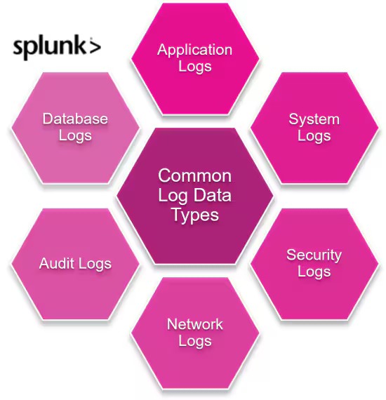
Splunk logs

Slide 38
How do we see all the logs in Splunk?
Navigate to Log Observer . In the content control bar, enter a time range in the time picker if you know it. Select Index next to Saved Queries, then select the indexes you want to query.

Slide 39

a variety of benefits that are offered by the Splunk
Real-time screen visibility.
Splunk offers Better Interface.
By offering instant results, it reduces troubleshooting and time-solving.
It is the most effective method for the study of root causes.

Slide 40

Splunk permits the generation of graphs, warnings, and dashboards.
Similar findings can be quickly checked and analyzed using Splunk.
It enables us to troubleshoot any failure state to improve performance.
Helps you to track and make educated decisions on every company measure.

Slide 41
Splunk allows Artificial Intelligence to be incorporated into the data strategy.
Helps you to gather useful Operational Intelligence from your system data
Splunk allows us to recognize any data type such as .csv, json, log formats, etc.
Provides the most powerful search and visualization tools to enable all types of users.
Allows us to establish a central server, where Splunk data can be searched from various sources.

Slide 42
Splunk has some essential features:
It accelerates the Development & Testing.
The building of Real-time Data Applications.
Generate ROI faster

Slide 43
Agile figures and Real-time architecture documentation.
Splunk also provides search, analysis, and visualization capabilities to empower users.

Slide 44

Thank you

